Slide 1
Introduction to Virtual Machines
Kartik Gopalan
From
“Virtual Machines” ,Smith and Nair, Chapter 1
Also, Chapter 7 Andrew Tanenbaum’s book

Slide 2
Virtualization
Makes a real system appear to be a set of virtual systems
One-to-many virtualization
E.g. one physical machine may appear as multiple virtual machines
one physical disk may look like multiple virtual disk
one physical network may look like multiple virtual networks
Many-to-one virtualization
Many physical machines/disks/networks may appear to look like one virtual machine/disk/network etc
Many-to-many virtualization
Extend the above statements.

Slide 3
Example: Disk Virtualization
Virtual
Disk 1
Virtual
Disk 2
Virtualization
File 1
File 2
Interface
Real
Disk

Slide 4
Virtual Machines
Logical/Emulated representations of full computing system environment
CPU + memory + I/O
Implemented by adding layers of software to the real machine to support the desired VM architecture.
Uses:
Multiple OSes on one machine, including legacy OSes
Isolation
Enhanced security
Live migration of servers
Virtual environment for testing and development
Platform emulation
On-the-fly optimization
Realizing ISAs not found in physical machines

Slide 5
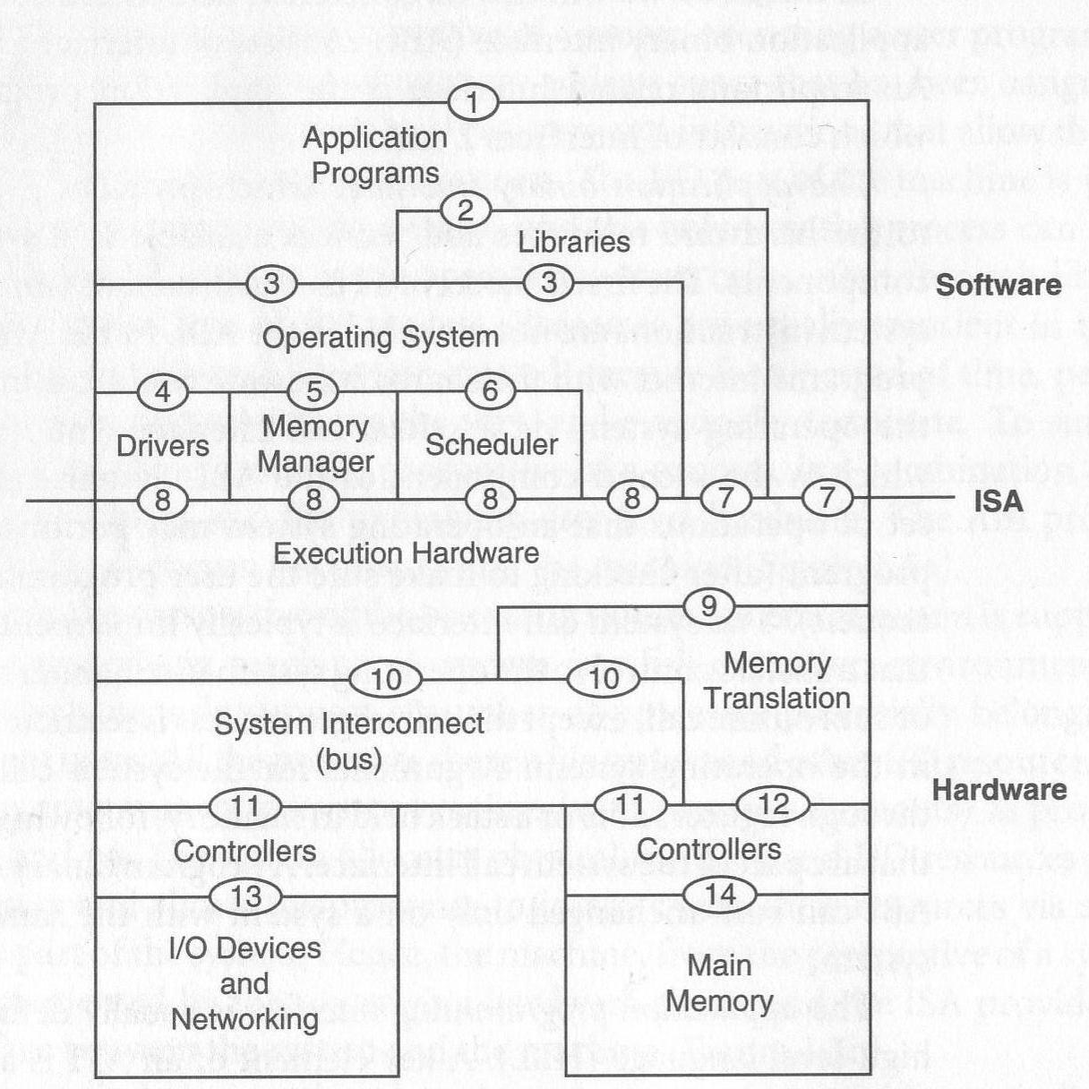
Interfaces of a computer system
User ISA : 7
System ISA : 8
Syscalls : 3
ABI : 3, 7
API : 2,7

Slide 6
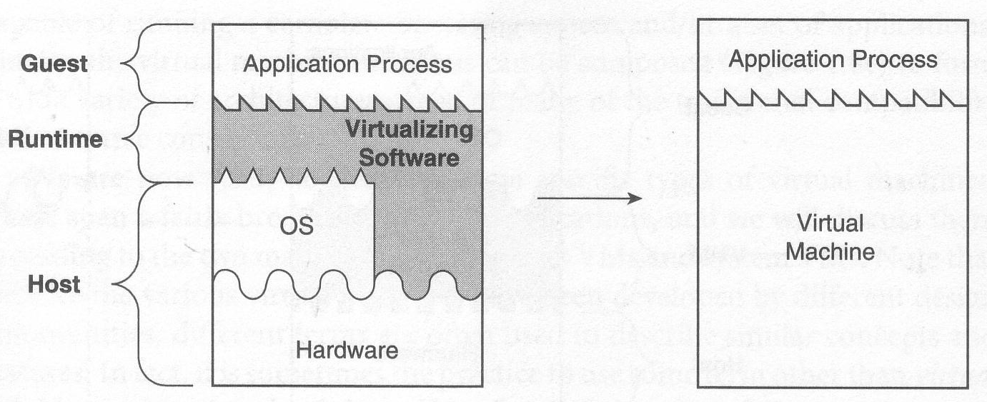
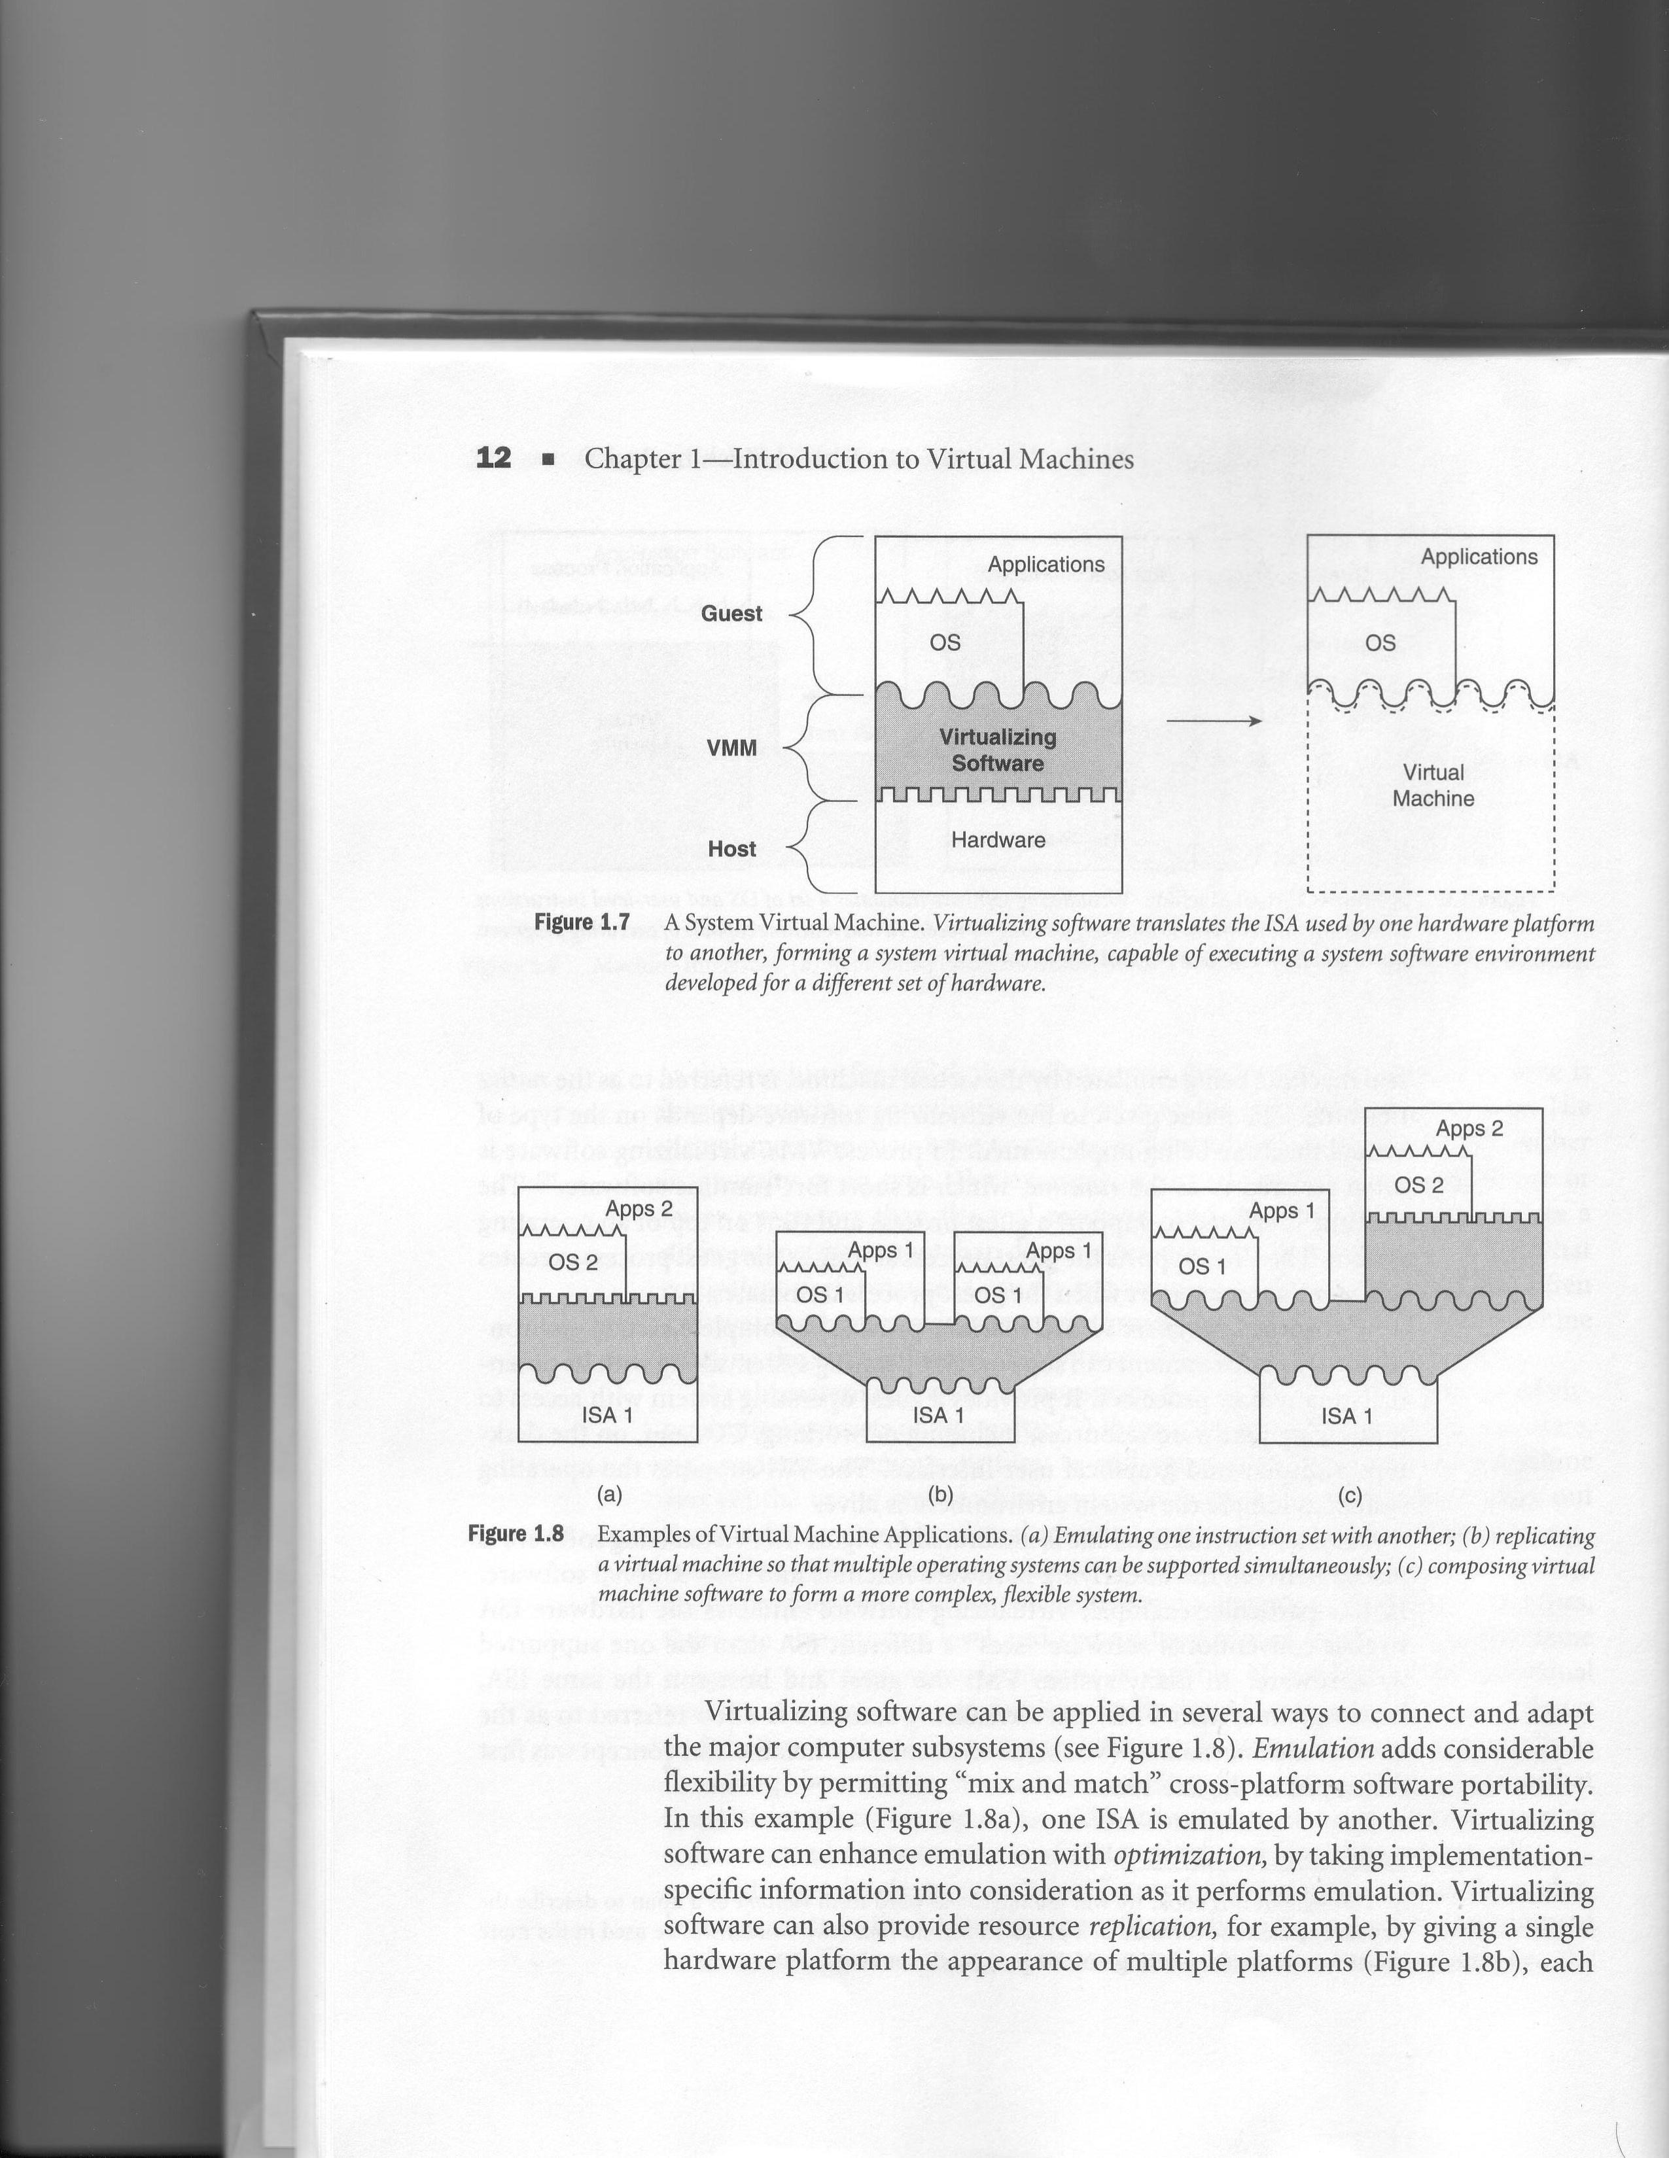
Two Types of VMs
Process VM
Virtualizes the ABI
Virtualization software = Runtime
Runs in non-privileged mode (user space)
Performs binary translation.
Terminates when guest process terminates.
System VM
Virtualizes the ISA
Virtualization software = Hypervisor
Runs in privileged mode
Traps and emulates privileged instructions
Lasts as long as physical host is alive

Slide 7
Process Virtual Machines
Process in a multiprogramming OS
Standard OS syscall interface + instruction set
Multiple processes, each with its own address space and virtual machine view.
Emulators
Support one ISA on hardware designed for another ISA
Interpreter:
Fetches, decodes and emulates individual instructions. Slow.
Dynamic Binary Translator:
Blocks of source instructions converted to target instructions.
Translated blocks cached to exploit locality.
Same ISA Binary Optimizers
Optimize code on the fly
Same as emulators except source and target ISAs are the same.
High-Level Language VMs
Virtual ISA (bytecode) designed for platform independence
Platform-dependent VM executes virtual ISA
E.g. Sun’s JVM and Microsoft’s CLI (part of .NET)
Both are stack-based VMs that run on register-based m/c.
IA-32 Windows APP
Windows NT
Runtime
Alpha ISA
Digital FX!32 Emulator
Java Application
Java Virtual Machine
OS
User ISA
ISA

Slide 8
System Virtual Machines
(focus of this lecture)

Slide 9
Hypervisor
Also called Virtual Machine Monitor (VMM)
A hypervisor is an operating system for operating systems
Provides a virtual execution environment for an entire OS and its applications
Controls access to hardware resources
When guest OS executes a privileged instruction, Hypervisor intercepts the instruction, checks for correctness and emulates the instruction.
Apps | Apps | Apps
Guest OS 1 | Guest OS 2 | Guest OS 3
Hypervisor
Hardware

Slide 10
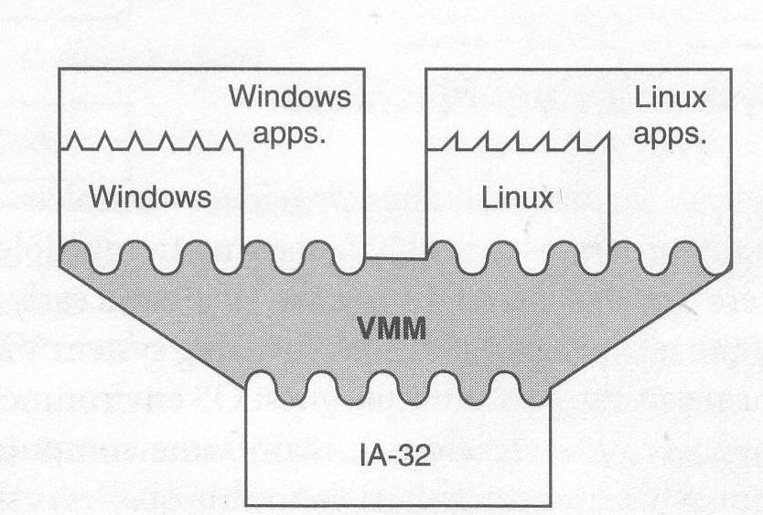
Type 1 Hypervisors (Classical System VMs)
Hypervisor executes natively on the host ISA
Hypervisor directly controls hardware and provides all device drivers
Hypervisor emulates sensitive instructions executed by the Guest OS
E.g. KVM and VMWare ESX Server

Slide 11
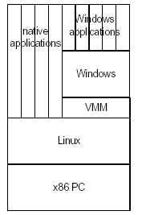
Type-2 Hypervisors (Hosted VMs)
A host OS controls the hardware
The Hypervisor runs partly in process space and partly in the host kernel
Hypervisor Relies on host OS to provide drivers
E.g. VMWare Desktop Client

Slide 12
Para-virtualized VMs
Modify guest OS for better performance
Traditional Hypervisors provide full-virtualization
They expose to VMs virtual hardware that is functionally identical to the underlying physical hardware.
Advantage : allows unmodified guest OS to execute
Disadvantage: Sensitive instructions must be trapped and emulated by Hypervisor.
E.g. KVM and VMWare ESX provide full virtualization
Para-virtualized VM
Sees a virtual hardware abstraction that is similar, but not identical to the real hardware.
Guest OS is modified to replace sensitive instructions with “hypercalls” to the Hypervisor.
Advantage: Results in lower performance overhead
Disadvantage: Needs modification to the guest OS.
E.g. Xen provides both para-virtual as well as full-virtualization
Often traditional Hypervisors are partially para-virtualizated
Device drivers in guest OS may be para-virtualized whereas CPU and Memory may be fully virtualized.

Slide 13
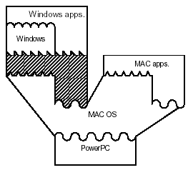
Whole System VMs: Emulation
Host and Guest ISA are different
So emulation is required
Hosted VM + emulation
E.g. Virtual PC (Windows on MAC)

Slide 14
Co-designed VMs
The hypervisor is designed closely with (and possibly built into) a specific type of hardware ISA (or native ISA).
Goal: Performance improvement of existing ISA (or guest ISA) during runtime.
Hypervisor performs Emulation from Guest ISA to Native ISA.
E.g. Transmeta Crusoe
Native ISA based on VLIW
Guest ISA = x86
Goal power savings

Slide 15
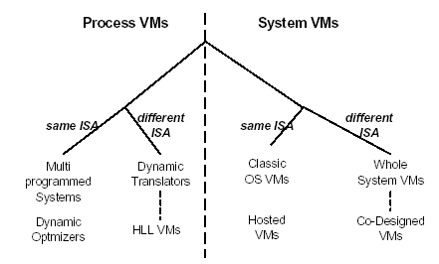
Taxonomy
Para-virtualized VMs
Hardware Virtual Machines

Slide 16
Versatility
Java App
Linux IA-32
Windows IA-32
Crusoe VLIW
JVM
VMWare
Code Morphing

Slide 17
What can you do with system VMs?
Emulation &
Optimization
Replication
Composition
Emulation: Mix-and-match cross-platform portability
Optimization: Usually done with emulation for platform-specific performance improvement
Replication: Multiple VMs on single platform
Composition: form more complex flexible systems

Slide 18
Virtualizing individual resources in System VMs

Slide 19
CPU Virtualization for VMs
Each VM sees a set of “virtual CPUs”
Hypervisors must emulate privileged instructions issued by guest OS.
Modern ISAs provide special interfaces for Hypervisors to run VMs
Intel provides the VTx interface
AMD provides the AMD-v interface
These special ISA interfaces allow the Hypervisors to efficiently emulate privileged instructions executed by the guest OS.
When guest OS executes a privileged instruction
Hardware traps the instruction to the hypervisor
Hypervisor checks whether instruction must be emulated.
If so, Hypervisor reproduces the effect of the privileged operation.

Slide 20
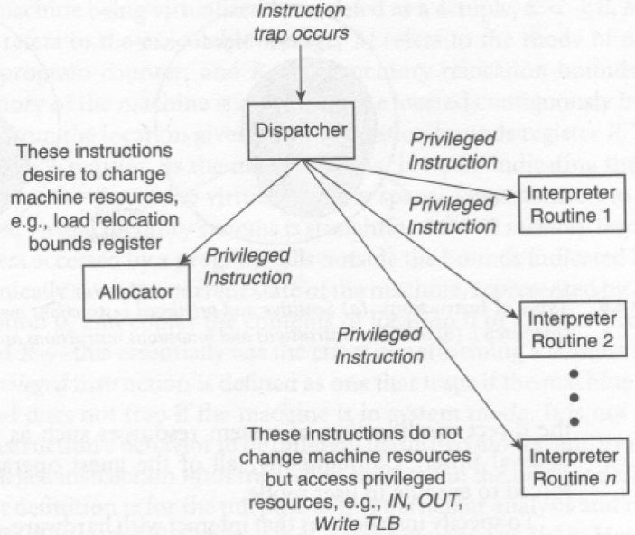
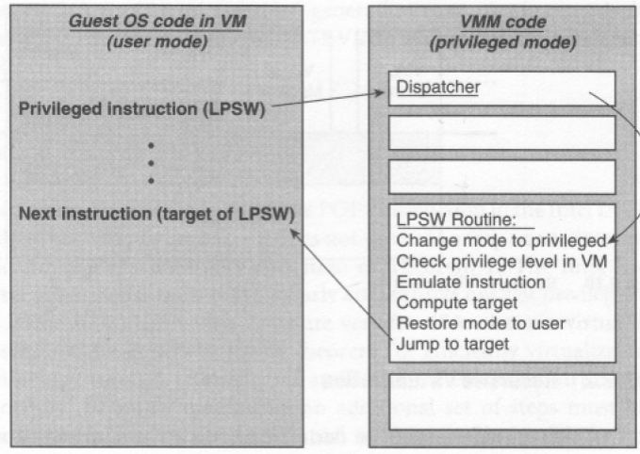
Execution of Privileged Instruction by Guest

Slide 21
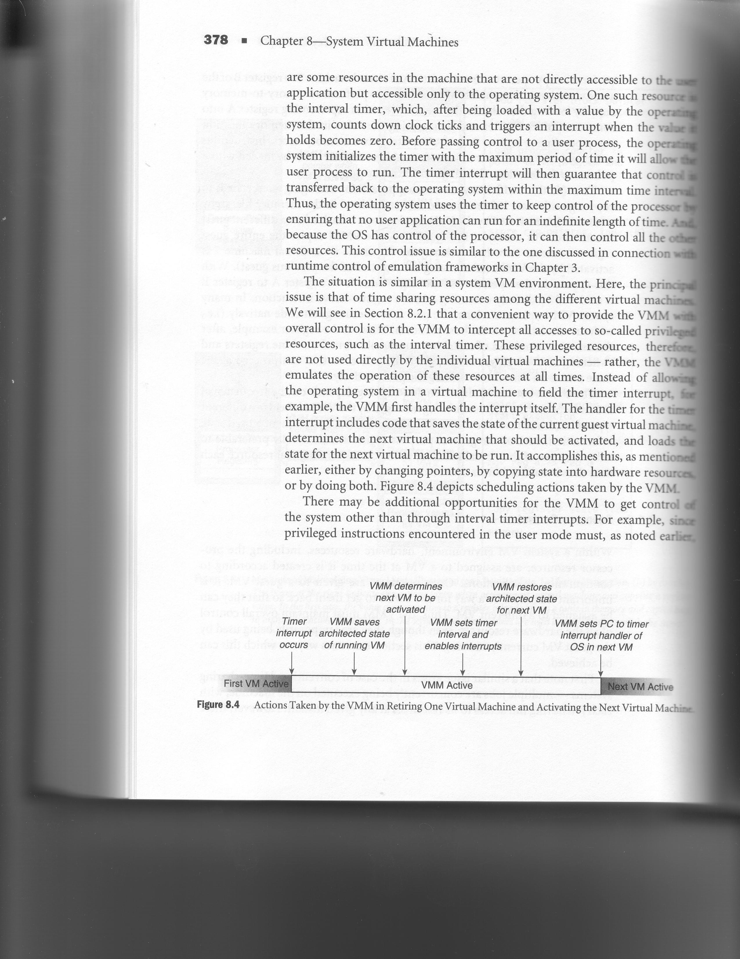
Resource Control
Issue: How to retain control of resources in the Hypervisor?
Timer interval control performed by Hypervisor
Also, guest OS is not allowed to read the timer value
Guest OS sees a virtual interval timer
Hypervisor also gains control whenever guest OS executes privileged instructions.

Slide 22
Memory Virtualization for VMs
Traditional virtual memory
Virtual Address Space
Physical Address Space
Virtual memory for VMs
Virtual Address Space
Guest Physical Address Space
Physical Address Space
Page Table
First-level Page Table
Second-level Page Table
Shadow Page Table
(optional)
Guest OS in each VM sees a “guest”-physical address (GPA) space instead of the physical addresses
Often hardware supports two-level page tables
EPT in Intel VT-x and NPT in AMD-v
When hardware doesn’t, then Hypervisor needs to emulate two-level page tables using “shadow page tables”.

Slide 23
I/O Virtualization for VMs
Hypervisor provides a virtual version of each physical device
I/O activity directed at the virtual device is trapped by Hypervisor and converted to equivalent request for the physical device.
Options:
Device emulation
Hypervisor traps and emulates each I/O instruction from Guest in Hypervisor.
Very slow.
Difficult to emulate the effect of combinations of I/O instructions.
Para-virtual devices
Special device drivers inserted in guest OS to talk to Hypervisor.
Most common.
Direct device access
Allow the VM to directly access physical device.
Fastest option but not scalable.
Requires IOMMU and VT-d support from hardware.

